Slide 1
Title: 🍕pizza_sales – SQL Data Analysis Project
Subtitle: Business Insights Using SQL Name: sagar Lavate Tools: SQL | MySQL | MySQLWorkbench

Slide 2
🎯 Problem Statement
To analyze pizza sales data using SQL and uncover key insights related to revenue, customer behavior, product performance, and time-based sales trends to support strategic business decision-making.

Slide 3
📌Project Overview
This project focuses on analyzing pizza sales data using SQL to extract meaningful business insights and support data-driven decision-making.
The objective was to explore order patterns, revenue trends, customer preferences, and product performance using structured queries ranging from basic aggregations to advanced window functions.

Slide 4
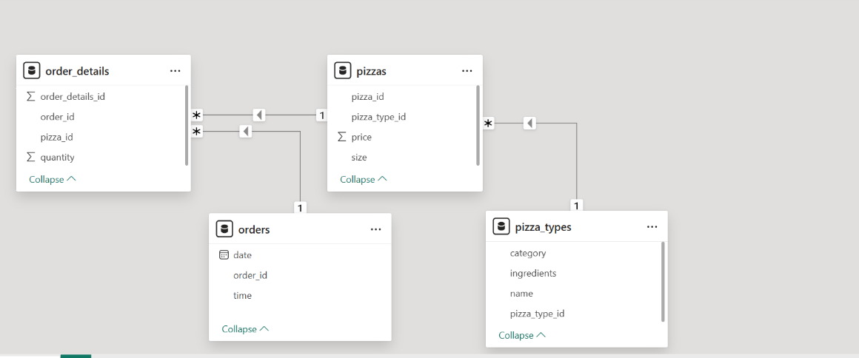
📊 Data Model – Pizza Sales Analysis
Built star schema data model
Established relationships between Orders, Order Details, Pizzas, and Pizza Types
Maintained 1-to-many relationships for accurate aggregation

Slide 5
📊 SQL Analysis Queries
This project involved writing structured SQL queries to analyze pizza sales data at multiple levels — from basic sales metrics to advanced revenue analytics.
🔹 Advanced Analysis
• Revenue % Contribution • Cumulative Revenue Trend • Category-wise Revenue Ranking (RANK())
🔹 Intermediate Analysis
• Category-wise Quantity • Hourly Order Distribution • Avg Orders Per Day • Top 3 by Revenue
🔹 Basic Analysis
• Total Orders & Revenue • Highest Priced Pizza • Most Ordered Size • Top 3 Pizzas (Quantity)

Slide 6
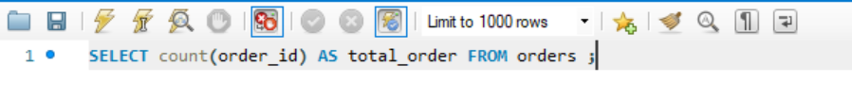
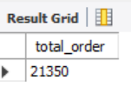
Retrieve the total number of orders placed.

Slide 7
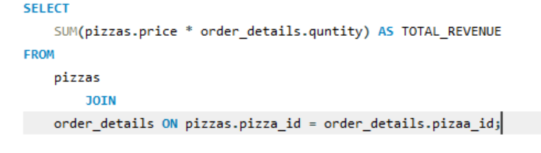
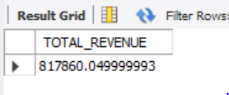
Calculate the total revenue generated from pizza sales.

Slide 8
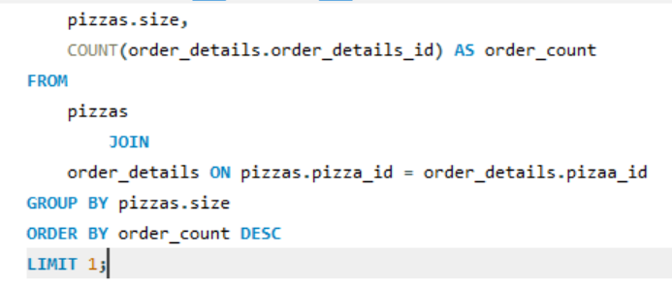
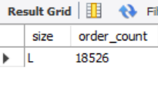
Identify the most common pizza size ordered.

Slide 9
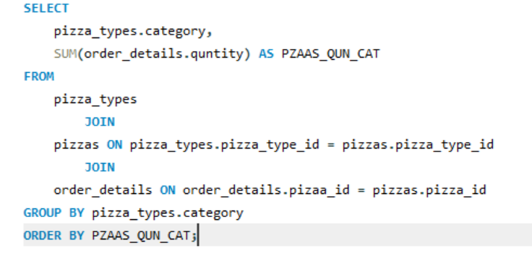
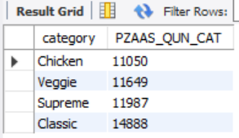
Join the necessary tables to find the total quantity of each pizza category ordered.

Slide 10
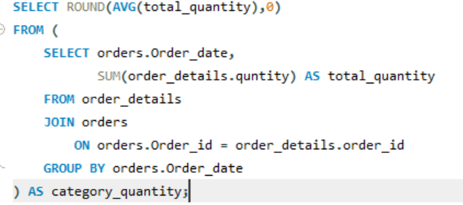
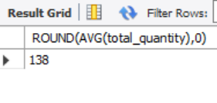
Group the orders by date and calculate the average number of pizzas ordered per day

Slide 11
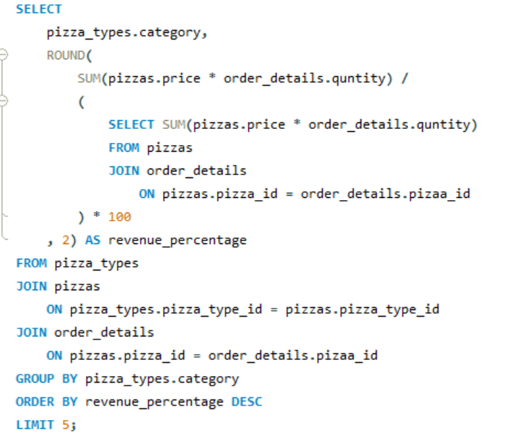
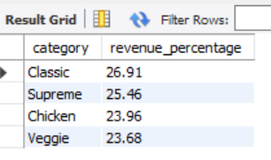
Calculate the percentage contribution of each pizza type to total revenue.

Slide 12
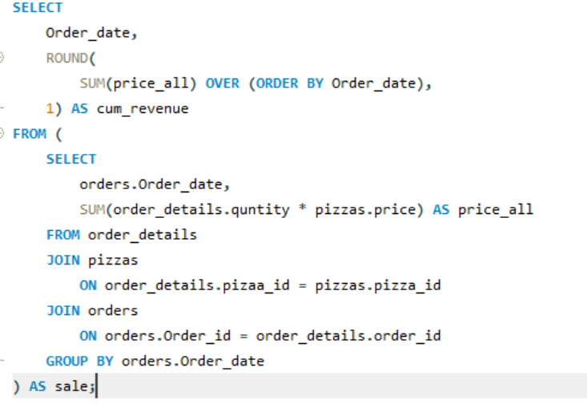
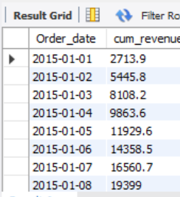
Analyze the cumulative revenue generated over time.

Slide 13
📊 Key Insights
💰 Revenue Insights
Identified top revenue-generating pizza types
Certain categories contributed significantly higher percentage to total revenue
High-priced pizzas did not always generate highest sales volume
🛒 Customer Behavior
Most customers preferred specific pizza sizes
Peak order hours were identified using time-based analysis
Daily average order volume showed consistent demand patterns
📦 Product Performance
Top 3 pizzas contributed major portion of total sales
Some categories had high demand but lower price margins
Revenue concentration highlighted best-performing segments
📈 Trend Analysis
Cumulative revenue showed steady business growth over time
Seasonal or time-based patterns can support marketing strategy

Slide 14
🎓 Conclusion & Learning
The SQL-based analysis successfully transformed raw transactional data into meaningful business insights. The project helped identify high-performing products, customer preferences, and revenue trends that can support strategic decision-making.

Slide 15

🙏 Thank You
Thank you for your time and attention.
.
📧 Contact: sagarlavate2025@gmail.com
https://www.linkedin.com/in/sagar-lavate

